Slide 1
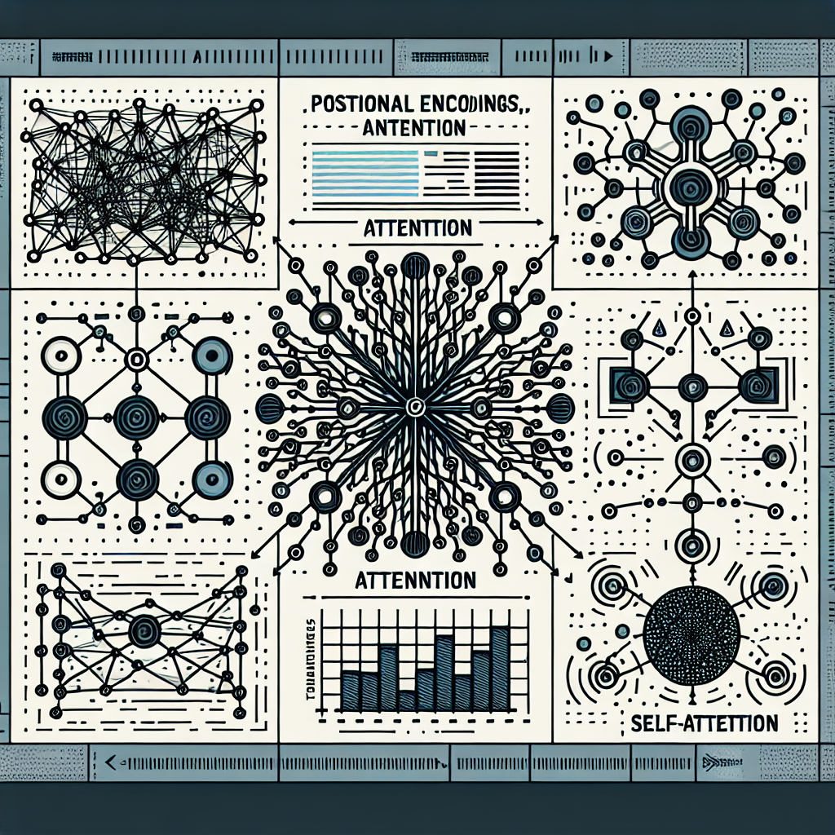
Understanding Transformers: The Revolution in Neural Networks
Positional Encodings, Attention, Self-Attention: Decoding Transformers

Slide 2
Understanding Transformers: The Revolution in Neural Networks
Introduction
Transformers are a type of neural network architecture that has revolutionized the field of machine learning, particularly in natural language processing. They excel in tasks like translation, text generation, and code writing, offering significant improvements over traditional models like recurrent neural networks. Their key innovations include positional encodings and attention mechanisms, with a focus on self-attention for understanding language context. Transformers, like BERT, have become essential tools in various applications, offering state-of-the-art performance in tasks such as text summarization, question answering, and classification.

Slide 3
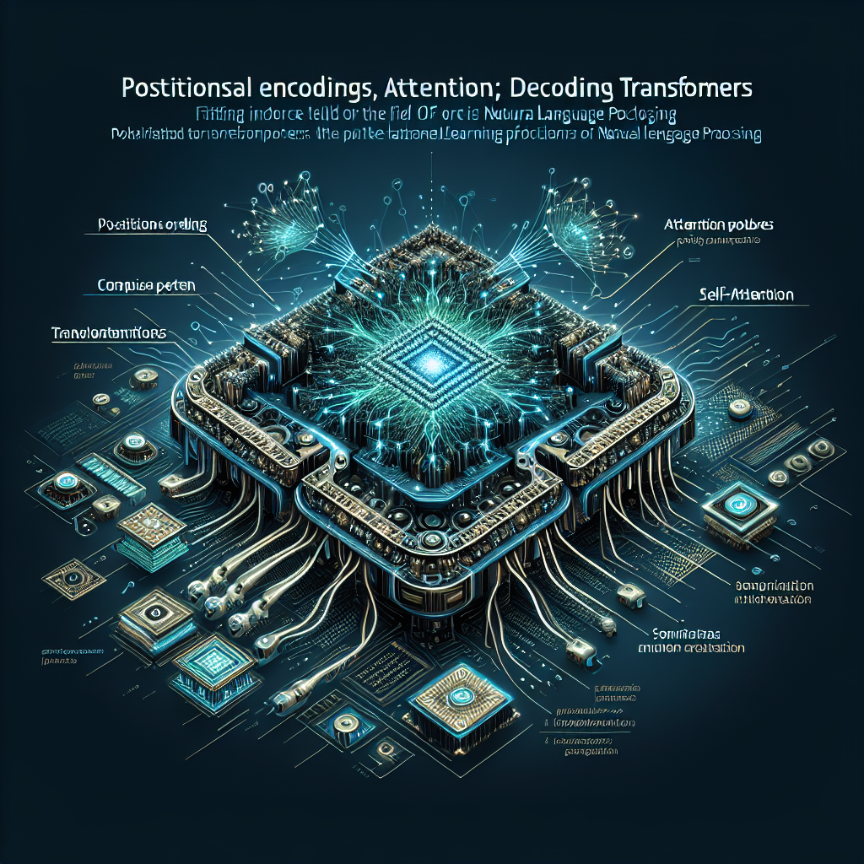
Understanding Transformers: The Revolution in Neural Networks
Transformers are a type of neural network that have revolutionized natural language processing.
They can translate text, write poems, generate computer code, and solve complex problems like the protein folding issue.
Models like BERT, GPT-3, and T5 are all based on transformers, making them crucial in the field of machine learning and NLP.

Slide 4
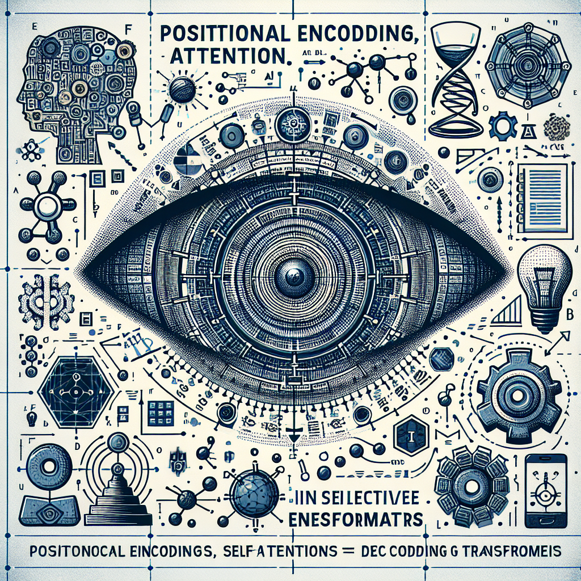
Understanding Transformers: The Revolution in Neural Networks
Transformers revolutionized machine learning by allowing efficient parallelization, enabling training of large models on massive datasets.
Positional encodings are used to encode word order in the data itself, making transformers easier to train than RNNs.
Attention mechanism, specifically self-attention, is a key innovation in transformers, allowing the model to focus on relevant parts of the input sequence.

Slide 5
Understanding Transformers: The Revolution in Neural Networks
Conclusion
The video discusses the impact of transformer neural networks in machine learning, particularly in natural language processing. Transformers have revolutionized the field by improving the handling of large text sequences and capturing word order effectively. The transformer model, developed in 2017, uses positional encodings and attention mechanisms to understand word order and context in text translation tasks. Transformers like BERT have been used in various applications and have outperformed previous models like Recurrent Neural Networks. They are valuable tools in NLP and machine learning for developers looking to enhance their applications.

Slide 6
Thanks

